Slide 1
Shopper Application A/B Testing

Slide 2
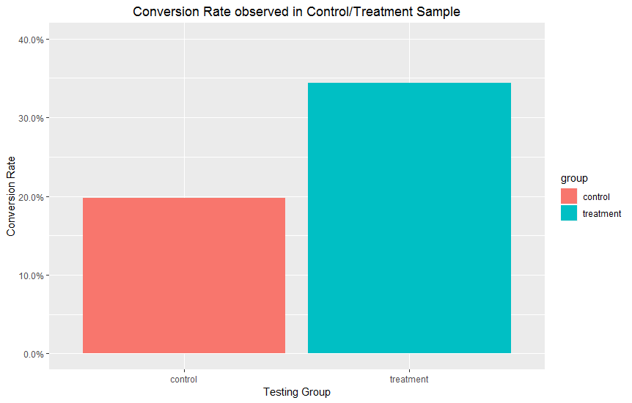
A/B Test Results and Conclusion
Control group had a 19.8% conversion rate (i.e. among 14501 unique applicants, 2873 completed their first batch)
Treatment group had a 34.3% conversion rate (i.e. among 7197 unique applicants, 2471 completed their first batch)
A two-sample t-test was used to investigate if the Treatment group’s conversion rate was statistically different from the Control group’s treatment rate
Our 95% confidence interval was calculated to be (-∞, -0.13)
This means that we are “95% confident” that the difference in the average conversion rates between Control and Treatment is nonzero​
In other words, Treatment group’s higher conversion rate is likely not just due to chance

Slide 3

Is The Suggested Change Cost-effective?
Starting background checks earlier is more expensive for us because we naturally will initiate more $30 background checks
In our A/B test, the typical control applicant costs $19.6, while the typical treatment applicant costs $26.6
However, we make up for this with the higher conversion rate for the treatment group (34.3% vs 19.8%)
The magnitude of the trade-off depends on the profit earned by a new shopper (imagine profit on completion of the first batch, or our cut of a shopper’s lifetime profit)
Break-even shopper’s profit $x=\frac{{Average Cost}_{ T} −{Average Cost}_{ C}}{{Conversion Rate}_{ T}−{Conversion Rate}_{ C}}=\$48.5$
Hence, if a shopper earns us $48.5 or more, then initiating background checks earlier is a cost-effective decision

Slide 4
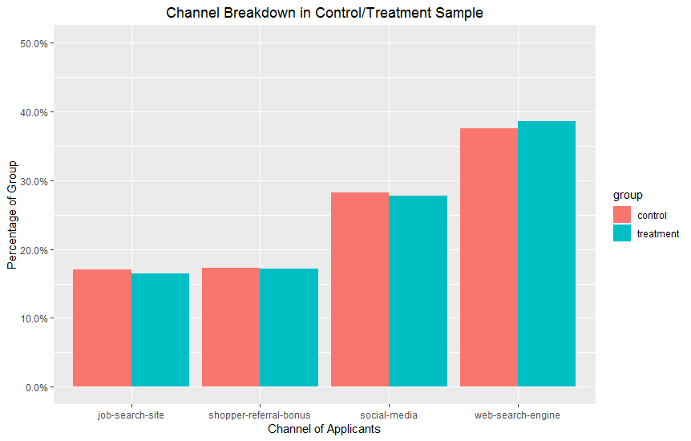
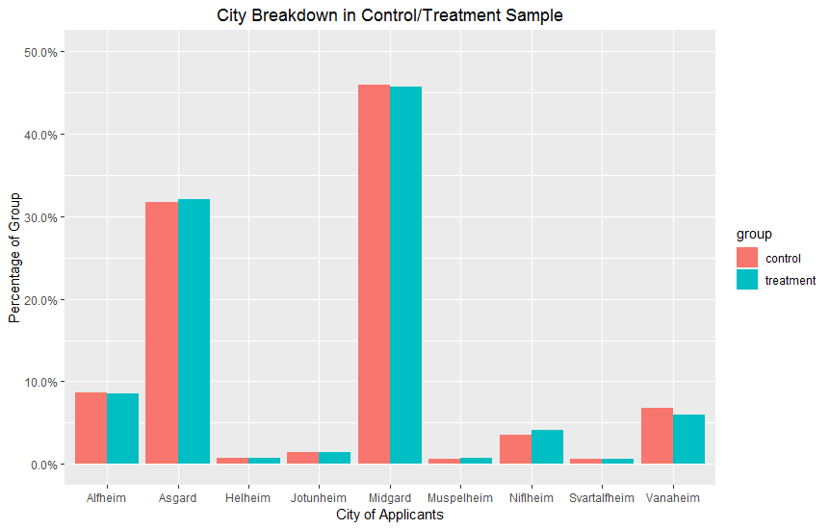
Conversion Days, Sample Profiles
We can use the A/B test to see how long it took for an applicant to convert
A typical applicant from the Control group took 10 days to convert, compared to 6.9 days for a Treatment group applicant
This difference in means is also statistically significant at the 95% level
We can check our samples to confirm both Treatment and Control populations are similar (to confirm the validity of our A/B Test
We see similarity in City breakdown and Channel breakdown

